Slide 1
Enhancing Hospital Efficiency: Predictive Analytics for Diabetic Patient Readmissions
Mohammed Nihal Akmal
Fazal Hyder Shaik
Professor: Dr. Rui Sun
Mercer University

Slide 2
Introduction
Goal:
This project aims to harness predictive analytics to identify risk factors and reduce the rate of hospital readmissions among diabetic patients
Data Source:
The dataset represents 10 years (1999-2008) of clinical care at 130 US hospitals and integrated delivery networks with records for 101,766 diabetic inpatients with 50 variable
Motivation:
Diabetes is a pervasive chronic condition affecting over 100 million individuals globally.
It is characterized by a notably high readmission rate; approximately 20% of diabetic patients are readmitted within 30 days post-discharge
These readmissions are not only clinically significant but also impose substantial financial burdens on healthcare facilities
Introduction
Methodology
Approach
Results
Recommendation

Slide 3
Data Description
Business Outlook
Data Processing
Variable Selection
Problem Statement
Data Pre- Processing
Some of the important attributes out of 50 variable:
Attributes | Type | Description and Values
Race | Categorical | Values: Caucasian, Asian, African American, Hispanic, and other
Gender | Categorical | Values: Male, female, and unknown/invalid
Age | Categorical | Grouped in 10-year intervals: [0, 10), [10, 20), ... , [90, 100)
Admission type | Categorical | Integer identifier corresponding to 9 distinct values, for example, emergency, urgent, elective
Time in hospital | Numeric | Integer number of days between admission and discharge
Payer code | Categorical | Integer identifier corresponding to 23 distinct values, for example, Blue Cross[Blue Shield, Medicare, and self-pay
Medical specialty | Categorical | Integer identifier of the admitting physician, corresponding to 84 distinct values, for example, cardiology, internal medicine, family\general practice, and surgeon
Number of procedures | Categorical | Number of procedures (other than lab tests) performed during the encounter
Number of diagnoses | Numeric | Number of diagnoses entered to the system
A1c test result | Categorical | Indicates the range of the result or if the test was not taken. Values: “>8” if the result was greater than 8%, “>7” if the result was greater than 7% but less than 8%, “normal” if the result was less than 7%, and “none” if not measured
Diabetes medications | Categorical | Indicates if there was any diabetic medication prescribed. Values: “yes” and “no”
Readmitted | Categorical | Indicates if the patient was readmitted in less than 30 days, “>30” if the patient was readmitted in more than 30 days, and “No” for no readmission within 30 days
Introduction
Methodology
Approach
Results
Recommendation
Evaluation
Perform Analysis
Accuracy Comparison
Conclusion
Model Building
Notes:
Explain briefly 4-5 names of variable
A1c test is a result to test blood sugar level

Slide 4
Methodology
Business Outlook
Data Processing
Variable Selection
Problem Statements
Data Pre- Processing
Evaluation
Perform Analysis
Accuracy Comparison
Conclusion
Model Building
Introduction
Methodology
Approach
Results
Recommendation

Slide 5
Problem Statements
What are the factors that influence a higher risk of readmission among diabetic patients?
How do demographic factors like age, sex, and race influence the readmission rates of diabetic patients?
How can we leverage our predictive model for readmission risk among admitted diabetic patients to improve patient care and reduce healthcare costs?
Introduction
Methodology
Approach
Results
Recommendation

Slide 6
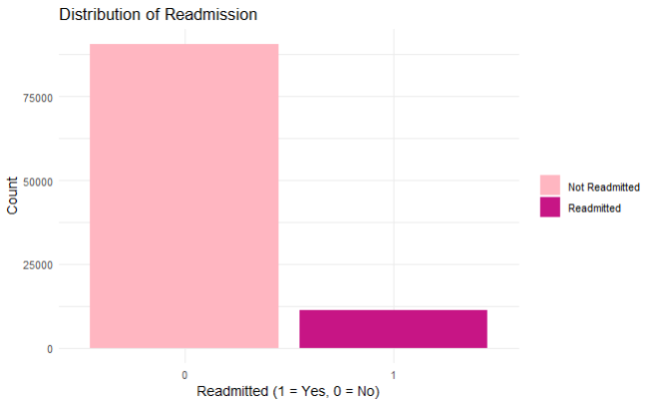
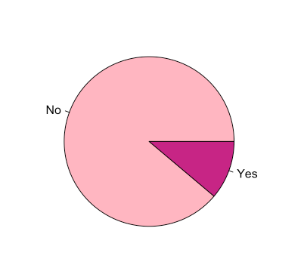
Data Pre Processing
Re-categorize Readmission group from 3 groups (<30, >30 days and NO) to 2 Groups (Readmission <30 days and Not Readmitted)
Introduction
Methodology
Approach
Results
Recommendation
Notes:
Data Specificity and Impact: Short-term readmissions are more likely to be directly related to the original medical issue rather than new, unrelated health problems that might emerge after a longer period. This makes the <30 day timeframe more relevant for interventions designed to improve patient outcomes directly connected to the initial hospitalization.

Slide 7
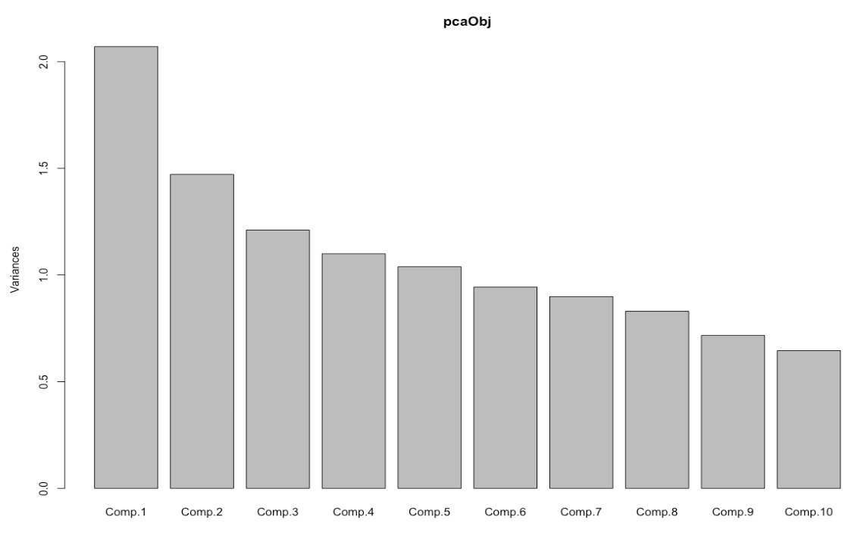
Data Pre Processing
Performed Principal Component analysis to reduce the data dimension as much as possible
Replaced missing values with constant ‘Other’
The PCA results indicate that the first 11 principal components explain approximately 96% of the variance, suggesting a substantial reduction in dimensionality is possible while still capturing key patterns in the data.
Introduction
Methodology
Approach
Results
Recommendation

Slide 8
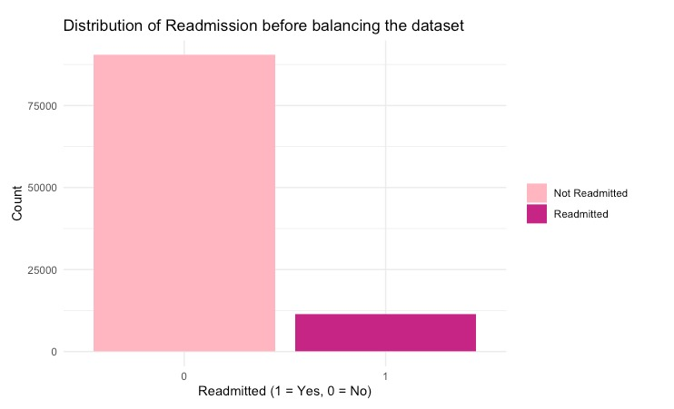
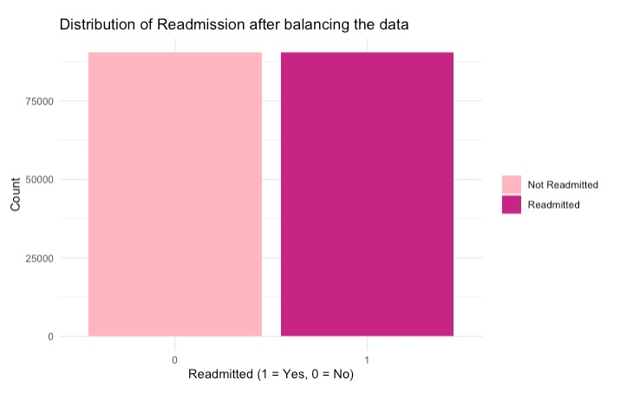
Data Balancing – SMOTE Technique
Balanced the data set through SMOTE Technique
  It helps to balance the class distribution of the original dataset by generating synthetic samples for the minority class.
0 1
90406 11357
0 1
90406 90406
Before
After
Introduction
Methodology
Approach
Results
Recommendation

Slide 9
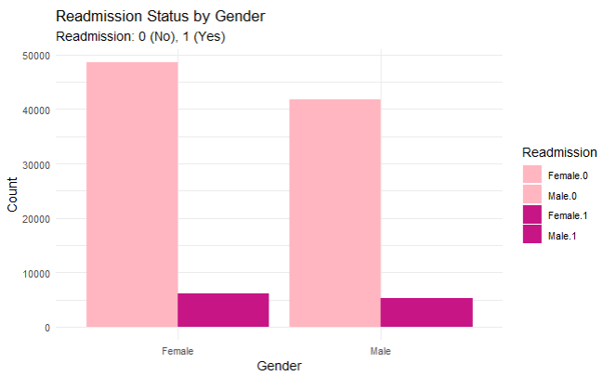
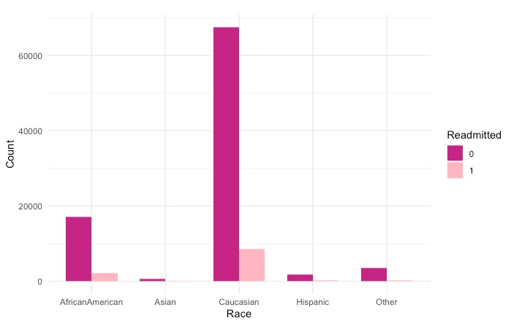
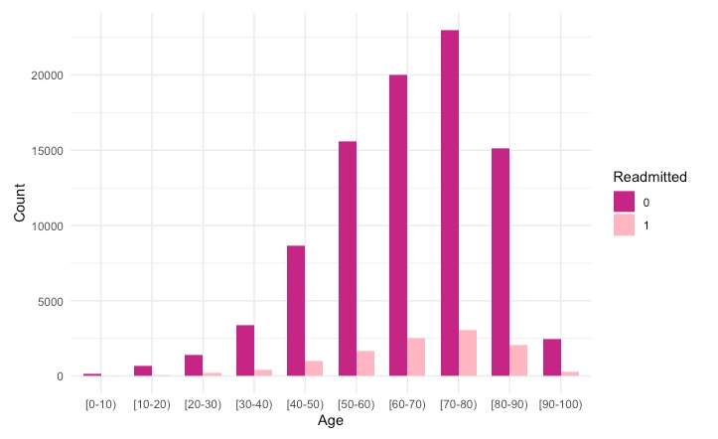
Exploratory Data Analysis – Gender, Race and Age
Females have comparatively higher readmission rate compared to male
Caucasian race have comparatively higher chances of readmission
Age range 70-80 years have higher chances of readmission
Introduction
Methodology
Approach
Results
Recommendation

Slide 10
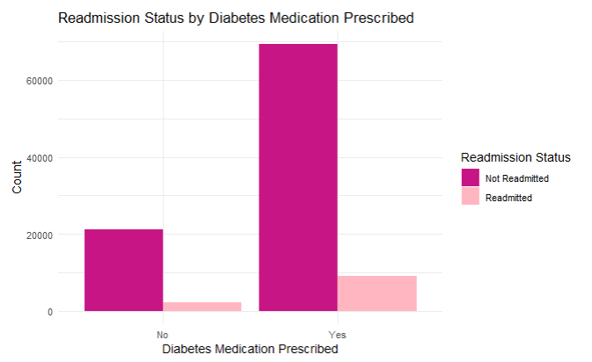
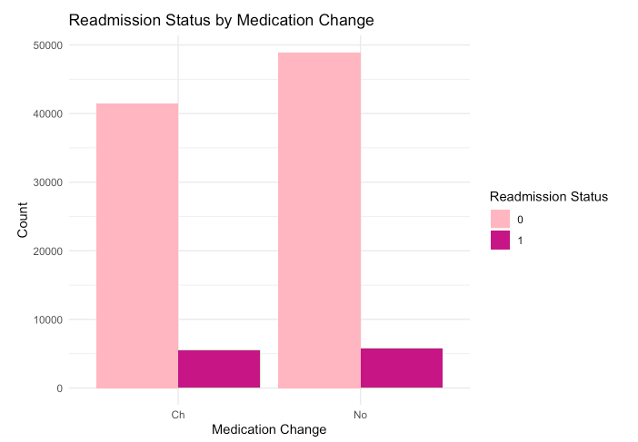
Exploratory Data Analysis
There is an increase in readmissions for patients prescribed with Diabetic Medication
There hasn’t been much difference in readmission with change in general medication
Introduction
Methodology
Approach
Results
Recommendation

Slide 11

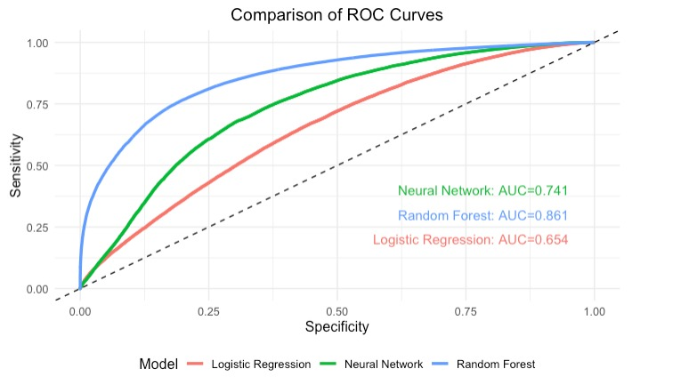
Model Evaluation
Model | AUC | Sensitivity | Specificity | Accuracy
Logistic Regression | 0.654 | 63.68% | 57.41% | 60.63%
Random Forest | 0.861 | 65.37% | 67.08% | 66.23%
Neural Network | 0.741 | 70.61% | 66.57% | 68.59%
* Neural Network model performs the best at predicting positive cases among the three models. It has the highest sensitivity rate, meaning it is the most effective at correctly identifying patients who are at risk of readmission.
Introduction
Methodology
Approach
Results
Recommendation
Notes:
Model
AUC
Sensitivity
Specificity
Accuracy
Logistic Regression
0.654
63.68%
57.41%
60.63%
Random Forest
0.861
65.37%
67.08%
66.23%
Neural Network
0.741
70.61%
66.57%
68.59%

Slide 12
Real World Prediction
Hypothetical Patient Profiles:
John Doe: Young Male with Minimal Hospital Visits
Scenario: John is a young male with minimal hospital interactions, not actively being treated for any chronic conditions.
Jane Doe: Elderly Female with Frequent Hospital Visits
Scenario: Jane is an elderly female, frequently hospitalized, with multiple diagnoses, and actively treated conditions.
Introduction
Methodology
Approach
Results
Recommendation

Slide 13
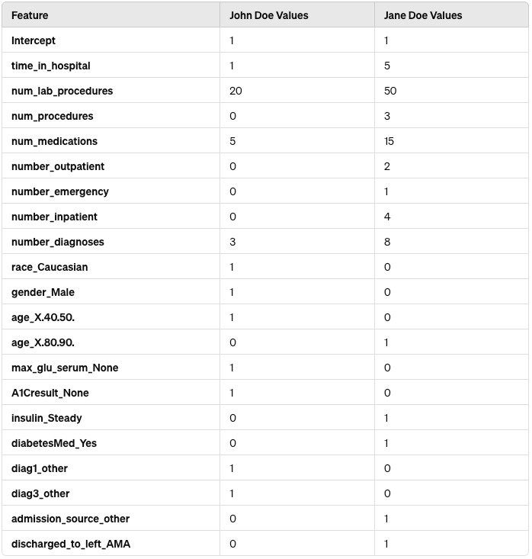
Real World Prediction
Neural Network Model Prediction result:
0 (John): The model predicts that John is not likely to be readmitted within 30 days.
1 (Jane): The model predicts that Jane is likely to be readmitted within 30 days.
Introduction
Methodology
Approach
Results
Recommendation

Slide 14
Recommendation
Targeted Premium Adjustments:
  Leverage data on age and the number of inpatient stays to adjust premiums more accurately. Older patients or those with frequent hospital admissions could be offered tailored plans that balance risk and cost more effectively.
  Software as a Service (SaaS):
  Develop the predictive model into a scalable SaaS product that other hospitals and healthcare providers can subscribe to. Offer customization and support services to enhance the client experience and add additional revenue layers.
  Early Intervention Programs:
  Implement early intervention programs for high-risk diabetic patients identified by the predictive model. These programs could include specialized care plans, medication management, and patient education aimed at reducing readmission risk
Introduction
Methodology
Approach
Results
Recommendation

Slide 15
Thank You!
Do you have any questions?

Slide 16
Refference
Dataset we are using is available at UC Irvine Machine Learning Repository .The Creators of the dataset are John Clore, Krzystof Cios , Jon DeShazo and Beata Strack. The data is licensed as Creativr Commons Attribution 4.0 International , which allows for the sharing and using the dataset if the credit is given to the creators.
Data can be downloaded from the below provided link.
https://archive.ics.uci.edu/dataset/296/diabetes+130-us+hospitals+for+years+1999-2008

Slide 17
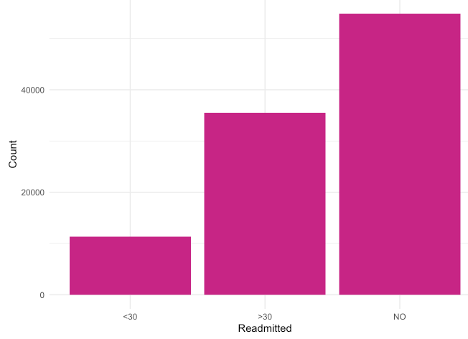
Appendix 1

Slide 18
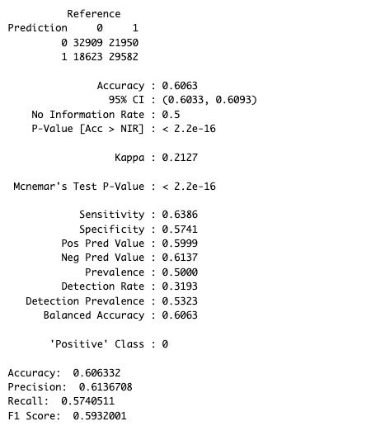
Appendix 2 – Logistic Regression

Slide 19
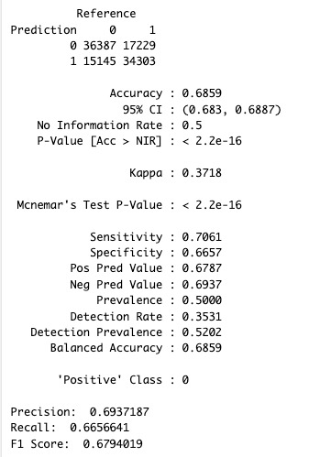
Appendix 3 – Random Forest

Slide 20
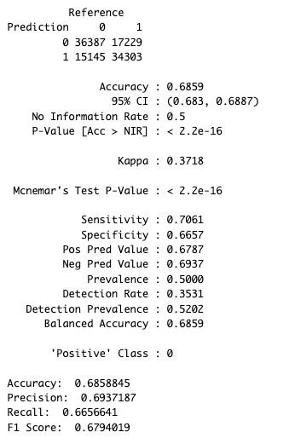
Appendix 3 – Neural Network

Slide 21
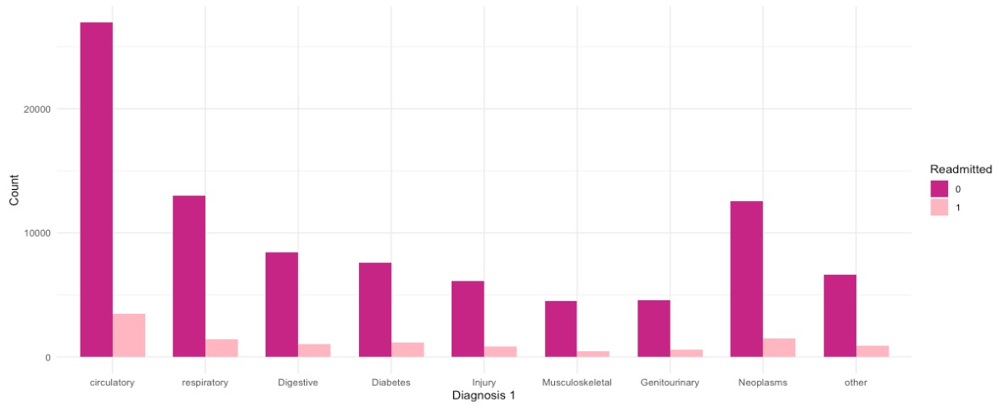
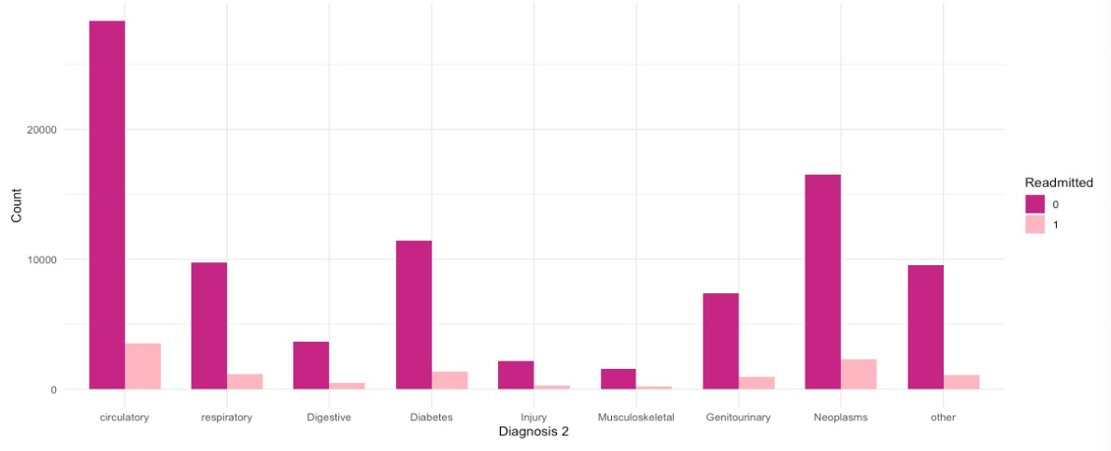
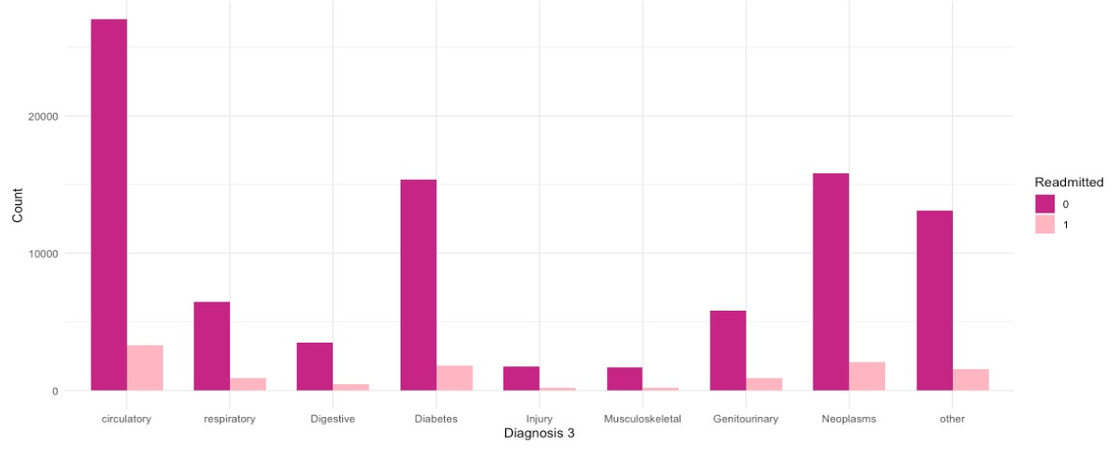
Appendix 4 – Diagnosis 1, 2 & 3
Diag - 1
Diag - 2
Diag - 3

Slide 22
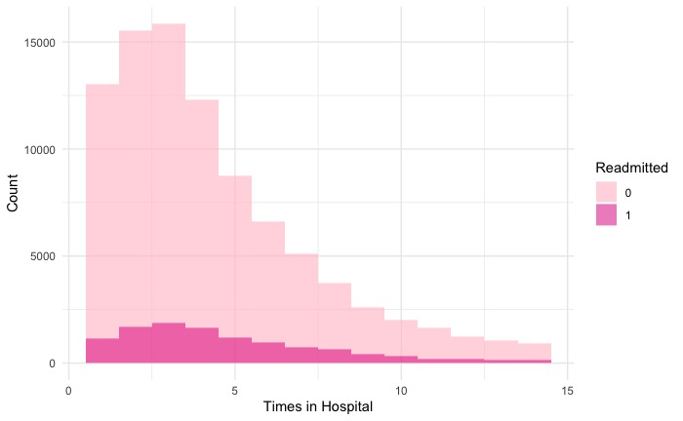
Appendix 5 – Time in Hospital

Slide 23
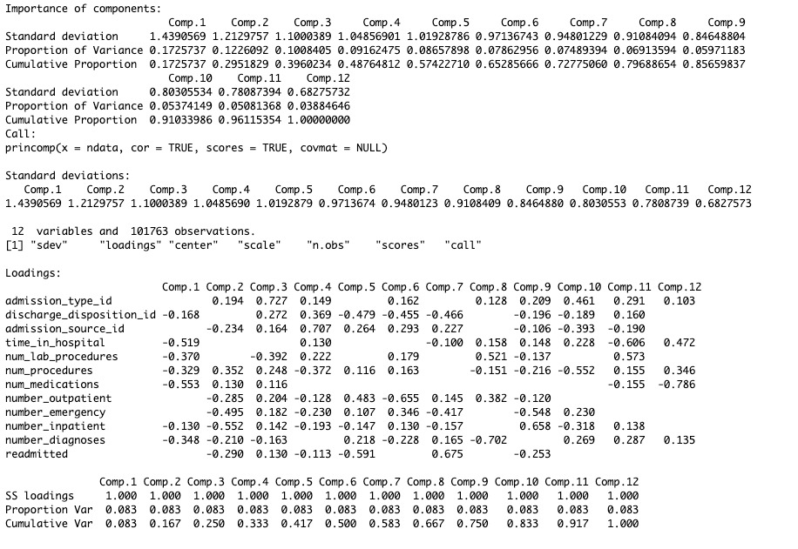
Appendix 6 – PCA

Slide 24
Appendix 7 – PCA
The PCA results indicate that the first 11 principal components explain approximately 96% of the variance, suggesting a substantial reduction in dimensionality is possible while still capturing key patterns in the data.

Slide 25
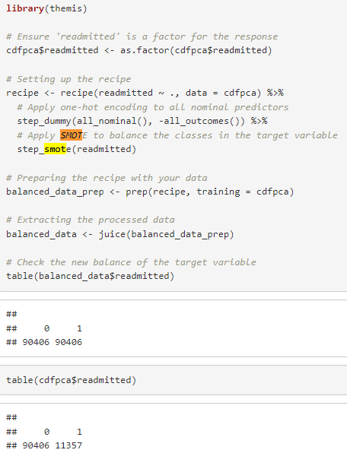
Appendix 8 – SMOTE Technique

